Slide 1
Tower of Hanoi visualization
Bikram biswas XXXXXXXXXX

Slide 2
What is tower of hanoi
Tower of Hanoi is a mathematical puzzle (we can say) where we have three rods and n disks . Here ‘n’ is the number of disks.
The value of ‘n’ can be any number starting from 1. In our project we have made the menu by which user can enter number of disks . Usually we put the value n=3.
The objective of the puzzle is to move the disks from one rod to another rod.

Slide 3
Moving of disks should follow the following rules:
Only one Disk can move at a time.
A Disk can only be moved if it is the uppermost disk on a stack.
No disk can be placed on the top of the smaller disk.

Slide 4
Lets Define a function which will represent the moves required to move the all disks to target rod.
towerOfHanoi (int n ,int src ,int dest ,int temp)
‘n’ means number of disks to be moved
Int src means rod where disk is present.
Int dest means rod where we the disk to be moved.
Int temp means the auxillary rod , remaining one.
So, tower of Hanoi (3,A,C,B)

Slide 5
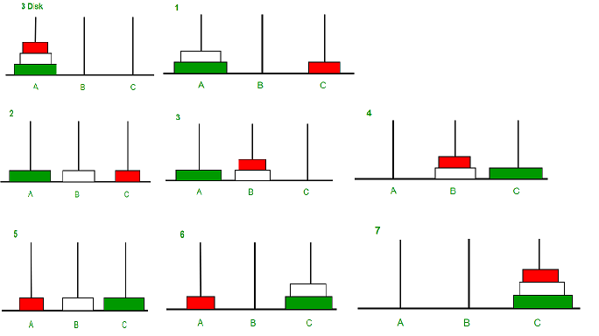
APPROACH
Take an example for 2 disks :
Let rod 1 = 'A', rod 2 = 'B', rod 3 = 'C’.
Step 1 : Shift first disk from 'A' to 'B'.
Step 2 : Shift second disk from 'A' to 'C'.
Step 3 : Shift first disk from 'B' to 'C’.
The pattern here is :
Shift 'n-1' disks from 'A' to 'B'.
Shift last disk from 'A' to 'C'.
Shift 'n-1' disks from 'B' to 'C'

Slide 6
How the entire stacks(3 disks) can be moved totally from tower A to tower C :
(For n=3)
1. Disk 1 moved from A to C
2. Disk 2 moved from A to B
3. Disk 1 moved from C to B
4. Disk 3 moved from A to C
5. Disk 1 moved from B to A
6. Disk 2 moved from B to C
7. Disk 1 moved from A to C

